Slide 1
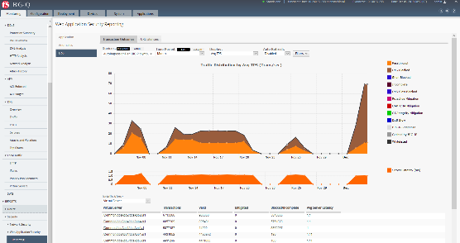







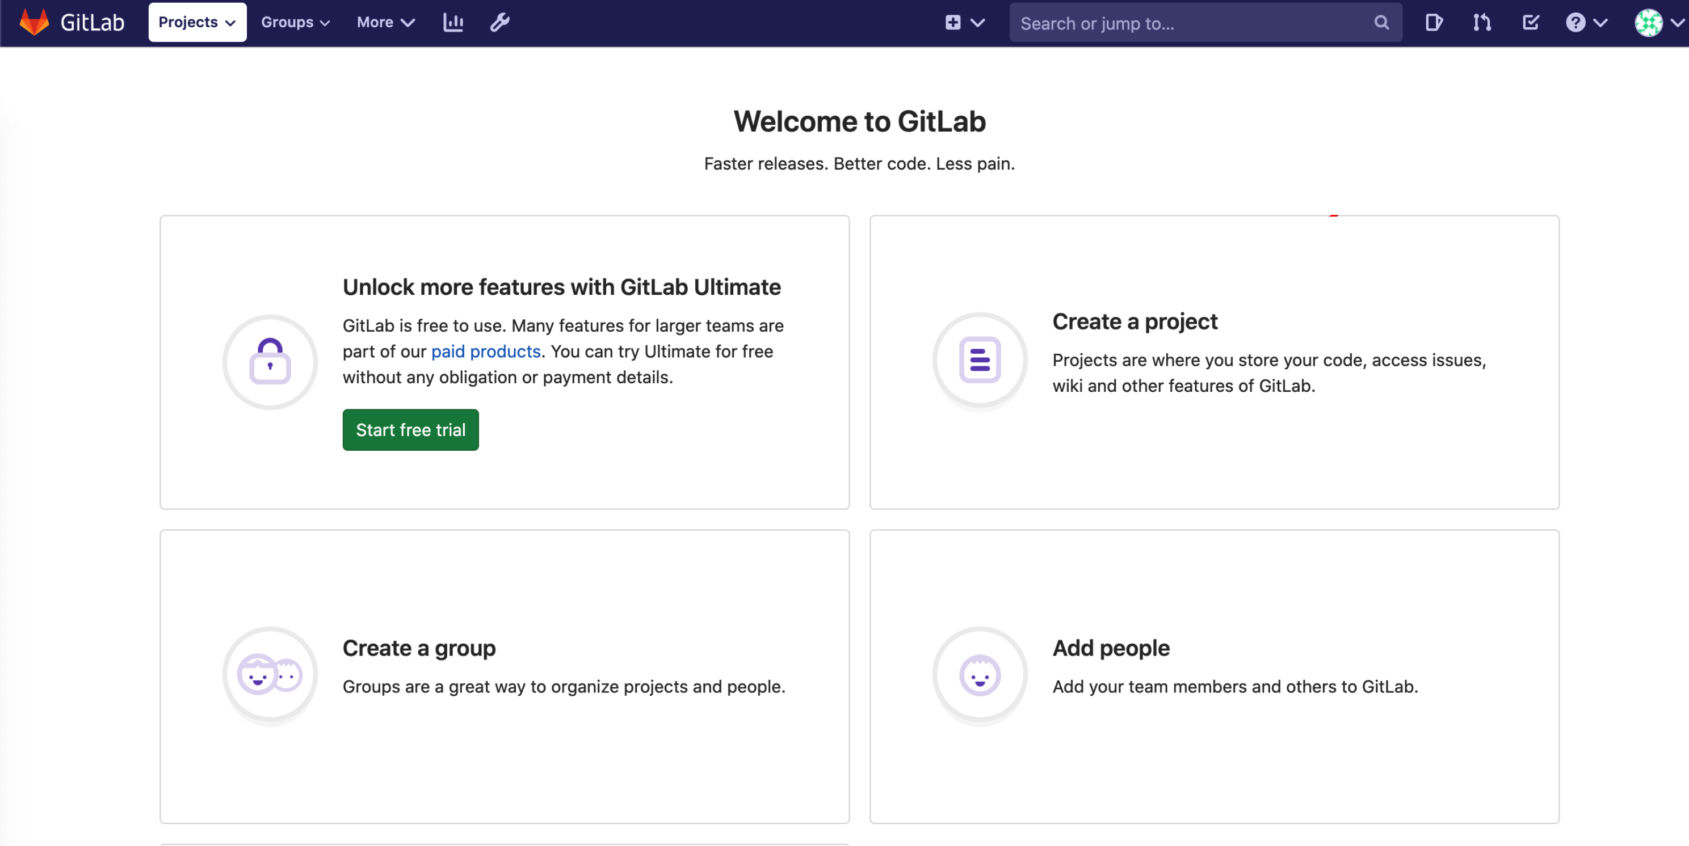
BIG-IQ Application Centric and Security Dashboards
AS3
AS3
BIG-IQ
AS3
BIG-IP
Triggered by GitLab Runners
AS3
AS3
Source Control
Automation
BIG-IP Orchestration
&
WAF Security Policy Management
Security Policy
BIG-IP
source of truth AS3
source of truth WAF policy

Slide 2
BIG-IQ Application Centric HTTP/TCP Dashboards
AS3
AS3
BIG-IQ
AS3
BIG-IP
Triggered by GitLab Runners
AS3
AS3
Source Control
Automation
BIG-IP Orchestration
BIG-IP
source of truth AS3

